Slide 1
Performance analysis of hyperparameters of fully connected neural network Machida Hiroaki

Slide 2
Table of Contents
Abstract
Introduction
Approach
Outcome
Conclusion
Reference

Slide 3
Examine how hyperparameters of fully connected neural network effects accuracy
Abstract
Purpose: This project examine how the hyperparameter (number of hidden layers and number of neurons per layer) of fully connected neural network changes the accuracy.
Design: The fully connected neural network uses the MNIST database of handwritten digit as training and test data.
Findings: The experiment showed that the higher number of neurons on each layer the model has, the more accurate the model is. On the other hand, it is counterintuitive, but the higher numbers of hidden layers resulted in worse accuracy.
Conclusion: Further investigation required, but, if there are too many hidden layers on training, the tail layer for higher-level features may discard information for lower-level features, and training falls into a local optimal solution.

Slide 4
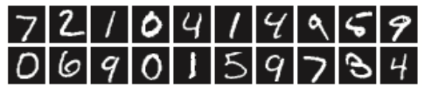
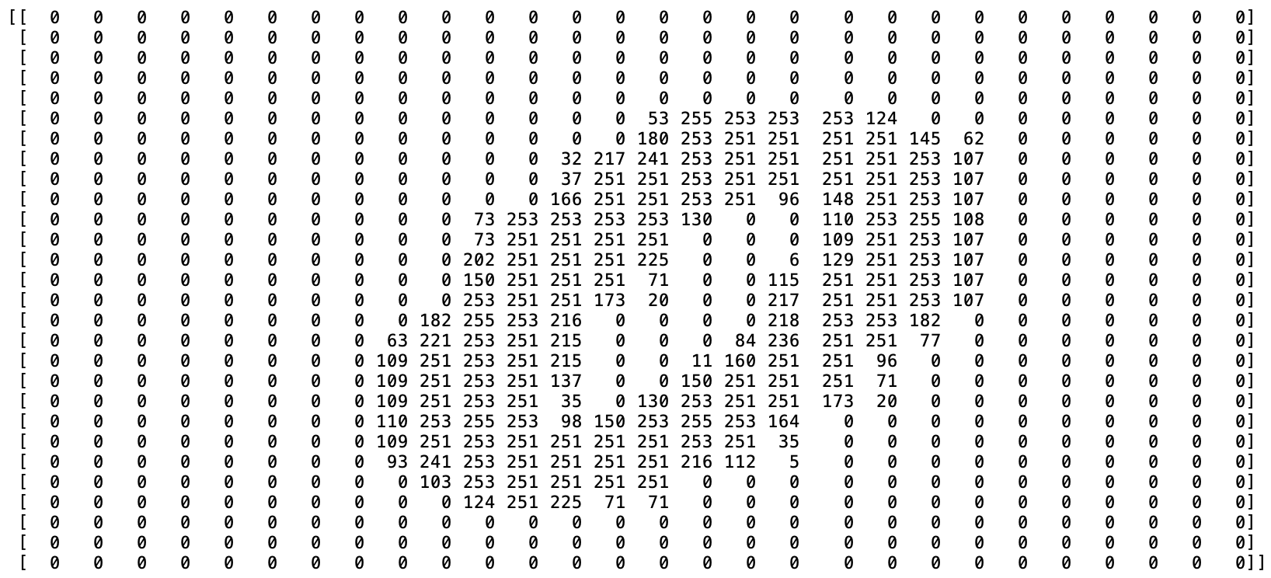
MNIST has 70,000 handwritten images in 28x28 pixels in gray level between 0 and 255 with labels
Introduction - MNIST database of handwritten digit
Images
…
a training set of 60,000 images and a test set of 10,000 images
Data
Gray level
between
0 and 255
28 x 28
pixels

Slide 5


Fully connected neural network consists of a series of fully connected layers
Introduction - Fully connected neural network
784 dots
50 neurons
10 neurons
10 values
[0, 0, 0, 0, 0, 0.95, 0.05, 0, 0, 0]
This is 95% 5!
…
…
$$x$$
The loss is 1.504…
Softmax-with-Loss
Affine
ReLU
Affine
[0, 0, 0, 0, 0, 1, 0, 0, 0, 0]
The answer is 5.
$x_{1}∗{weight}_{1}+⋯+x_{784}∗{weight}_{784}+bias=y$

Slide 6
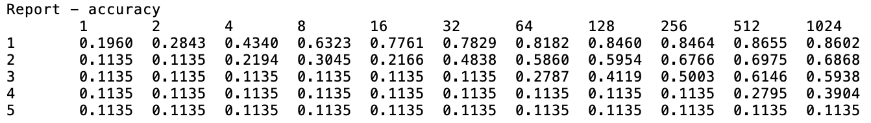
Conduct 50,000 iterations for each combination of number of neurons and number of hidden layers
Approach
1
2
3
Start
Set hyperparameters
Train &
measure accuracy
All
done?
End
1
Set hyperparameters with the combination of number of layers = [1,2,3,4,5] and number of neurons per layer = [1,2,4,8,16,32,64,128,256,512,1024,2048]
Train with 50,000 iterations with the training set and measure accuracy(, time and memory) with the test set
In the end, get matrices of x:# of neurons on each layer and y:# of layers
2
3

Slide 7
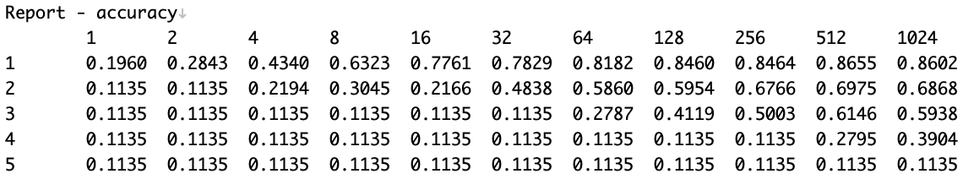
The higher number of hidden layers, the worse accuracy
Outcome - Accuracy
2
1
1
The higher number of hidden layers the model has, the worse accuracy gets
The higher number of neurons each layer has, the better accuracy gets
2

Slide 8
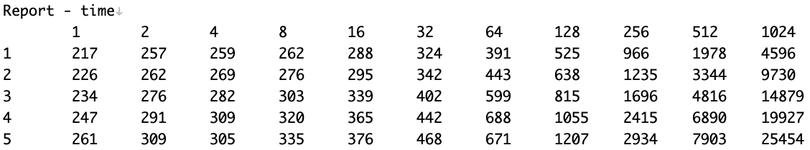
Time increases linearly on the big neural networks
Outcome - Time
1
1
The time to train gets longer linearly as the neural network gets bigger

Slide 9
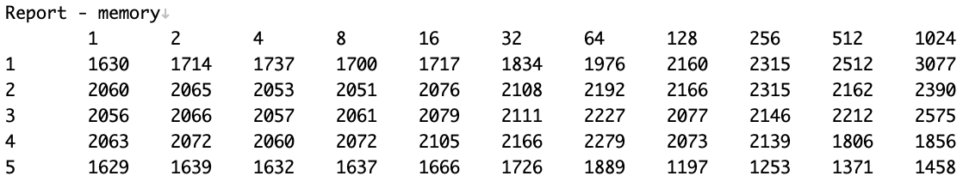
The size of neural network hardly effects the size of memory
Outcome - Memory
1
1
The size of neural network hardly effects memory. Rather, memory decreased as the neural network gets bigger for some reason.

Slide 10
Too many hidden layers might discard important lower-level features
Conclusion (1/2)
1
Why number of neurons per layer is more important than number of layers?: As intuition, accuracy gets better as the number of neurons on each layer increases. In contradiction to that, accuracy of fully connected neural network gets worse as the number of hidden layers increases. Ian Goodfellow^{[1]} points out that increasing the number of hidden layers much more than the sufficient number of layers will cause accuracy in the test set to decrease because of overfitting. However, an experiment in hand showed that even the maximum training accuracy of 2 layers with 1024 neurons per layer is as low as 0.70723, that is lower than 0.8602 of the test accuracy of 1 layer with 1024 neurons per layer. Hence, this is not the matter of overfitting. Further investigation required, but the hypothesis is that the 2nd hidden layer for higher-level features discards information for lower-level features that is important for such small images (28x28 pixels), and training falls into a local optimal solution.
[1] Ian Goodfellow and Yoshua Bengio and Aaron Courville, “Deep Learning”, p.110

Slide 11
Ones suggestion is to use genetic algorithm to find better combination of hyperparameters
Conclusion (2/2)
2
What is optimum ratio number of neurons per layer to number of layers?: In the MNIST case, the higher number of neurons per layer, the better accuracy, without considering training time. What number of hidden layers is the best is yet to be investigated. One suggestion is to use genetic algorithm to identify what number of neurons per layer and number of hidden layers is the best. For example, assume the accuracy of 1 layer with 64 neurons per layer is already calculated, next calculate the accuracies of 1 layer with 128 and 2 layer with 64. If 1 layer with 128 is better, then calculate 1 layer with 256 and 2 layer with 128. Then, keep this process until the accuracy doesn’t get improved.
Memory: Memory is hardly effected by the size of neural network. That might be because the initial memory of python process is so huge (around 1.6GB) that it can be ignored.
Time: Time increases linearly on the big neural networks.
3
4

Slide 12
Appendix

Slide 13














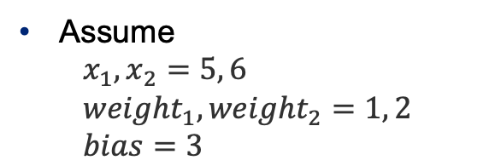
















Gradient of weight or bias to loss can be calculated from right to left
Appendix: gradient calculation(Affine layer)
$x$₁
$x_{1}∗{weight}_{1}+x_{2}∗{weight}_{2}+bias=y$
$x$₂
Assume
$$x_{1}, x_{2}=5, 6$$
$${weight}_{1}, {weight}_{2}=1, 2$$
$$bias=3$$
$$x_{1}$$
$$\vec{5}$$
$$\overset{⃖}{1∙E}$$
$×$
$$\vec{1}$$
$$\vec{5}$$
$${weight}_{1}$$
$$\overset{⃖}{5∙E}$$
$$\overset{⃖}{1∙E}$$
$$\vec{17}$$
$$\vec{20}$$
$+$
$+$
$$y$$
$$x_{2}$$
$$\vec{6}$$
$$\vec{12}$$
$$\overset{⃖}{1∙E}$$
$$\overset{⃖}{1∙E}$$
$$\overset{⃖}{2}∙E$$
$×$
$$\overset{⃖}{1∙E}$$
$$\vec{2}$$
$$\vec{3}$$
$${weight}_{2}$$
$$\overset{⃖}{6∙E}$$
$$\overset{⃖}{1∙E}$$
$$bias$$
If ${weight}_{2}$ increases by 1, $y$ increases by 6.
So, let’s decrease ${weight}_{2}$ by 6 * learning_rate (let say, 0.1) = 0.6 next time!
(if the loss decreases if do so.)

Slide 14
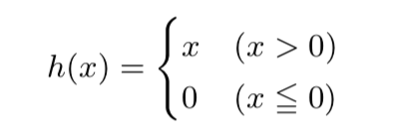
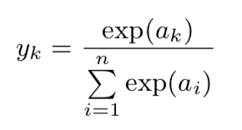
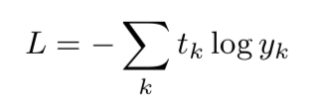
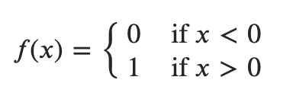

Need to calculate the gradients of the ReLU layer and Softmax-with-loss as well
Appendix: gradient calculation(ReLU, Softmax-with-loss)
ReLU
Function
Gradient
Softmax-with-loss
Function
Gradient
$f\left(x\right)=y_{k}−t_{k}$

